Slide 1

TWITTER SENTIMENT ANALYSIS FOR US ELECTIONS
DATA WAREHOUSE AND MINING
TEAM MEMBERS
2010030374 – JAIDEEP SHARMA
2010030413 – NIHAL AGARWAL
2010030361 – T VENKATA SAI SATHVIK
2010030153 – SHAIK ABDUL SHAAN

Slide 2
TABLE OF CONTENTS
S. No. | TITLE | Slide No.
1 | PROJECT AREA | 3
2 | LITERATURE SURVEY | 4
3 | OBJECTIVE | 6
4 | PROBLEM STATEMENT | 7
5 | DATASET COLLECTION | 8
6 | WORK PROGRESS | 11
7 | OUTPUT | 26
8 | GITHUB REPOSITORY | 34
9 | CONCLUSION | 35

Slide 3
PROJECT AREA
The main aim for selecting this project is to analyse the sentiments and visualize the polarity of comments, whether it is a negative, positive or neutral so that it can lead to better result prediction.
25-10-2022
BATCH - 11 TWEETS SENTIMENT ANALYSIS FOR US ELECTIONS - 2020
3

Slide 4
LITERATURE SURVEY
Sno | Author | Title | Publishing | Techniques and datasets | Pros | Cons
1. | Rao hamza ali, gabriela pinto, evelyn lawrie & erik J. Lin stead | A large-scale sentiment analysis of tweets pertaining to the 2020 US presidential election | Journal of big data | Donald trump, trump, biden, joe biden, biden. Vader model. | Analysis on all tweets for us 2020 elections between biden and trump. | Sarcasm was not detected by this model which uses VADER.
2. | Ussama yaqub, soon ae chun, vijayalakshmi atluri, jaideep vaidya | Sentiment based analysis of tweets during the US presidential elections | Research gate | Sentiment analysis, social media, behaviour analysis, elections. | Analysed approximately 3 million twitter messages associated with US presidential elections of 2016. | Some tweets were accurate while some were hard to analyse.
25-10-2022
BATCH - 11 TWEETS SENTIMENT ANALYSIS FOR US ELECTIONS - 2020
4

Slide 5
LITERATURE SURVEY
Sno | Author | Title | Publishing | Techniques and datasets | Pros | Cons
3. | Manch hui, devlikamov vlad, harikrishna C. | Sentiment analysis on US election 2020 tweets. | Kaggle | Sentiment analysis, social media, behaviour analysis, elections. | Tweets collected, using the twitter API statuses_lookup and snsscrape for keywords, with the original intention to try to update this dataset daily so that the timeframe will eventually cover 15.10.2020 and 04.11.2020 | The dataset has a lot of messy data as some of the attributes don’t get converted into needy ones.
4. | Alexander shevtsov, maria oikonomidou, despoina antonakaki, polyvios pratikakis, sotiris ioannidis. | Analysis of twitter and youtube during uselections 2020 | Arxiv | Online social networks, twitter, youtube, sentiment analysis | It demonstrates sentiment analysis on the twitter corpus and the youtube metadata and shows that the positive sentiment is higher for donald trump in comparison with joe biden. | Sarcasm was not detected by this model
25-10-2022
BATCH - 11 TWEETS SENTIMENT ANALYSIS FOR US ELECTIONS - 2020
5

Slide 6
OBJECTIVE
By reviewing the previous published paper, the main problem is the model cant detect the sarcastic comments, so we are using state vector machine in NLP to detect the sarcasm and the polarity check using Text Blob and random forest.
25-10-2022
BATCH - 11 TWEETS SENTIMENT ANALYSIS FOR US ELECTIONS - 2020
6

Slide 7
PROBLEM STATEMENT
The classification of twitter data based on tweets aims to provide efficient and accurate graphical representation of likes, tweets and favor in US presidential elections using sentiment analysis and deriving visualization graphs from it. There are different users who has tweeted either for Trump to win or Biden to win and other users has retweeted it either supporting or rejecting. Based on all these tweets we can derive a final graph and analysis whether Trump or Biden is going to win US presidential elections hypothetically according to people’s views and thoughts. This metadata serves the purpose of helping community to filter relevant opinions more efficiently.
25-10-2022
BATCH - 11 TWEETS SENTIMENT ANALYSIS FOR US ELECTIONS - 2020
7

Slide 8
DATASET TO BE USED
https://www.kaggle.com/datasets/manchunhui/us-election-2020-tweets

Slide 9
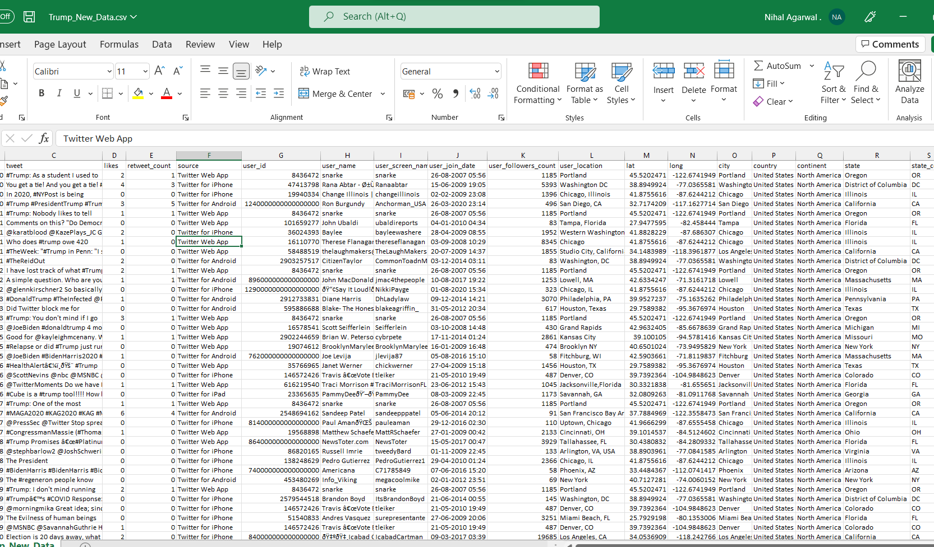
TRUMP DATASET
25-10-2022
BATCH - 11 TWEETS SENTIMENT ANALYSIS FOR US ELECTIONS - 2020
9

Slide 10
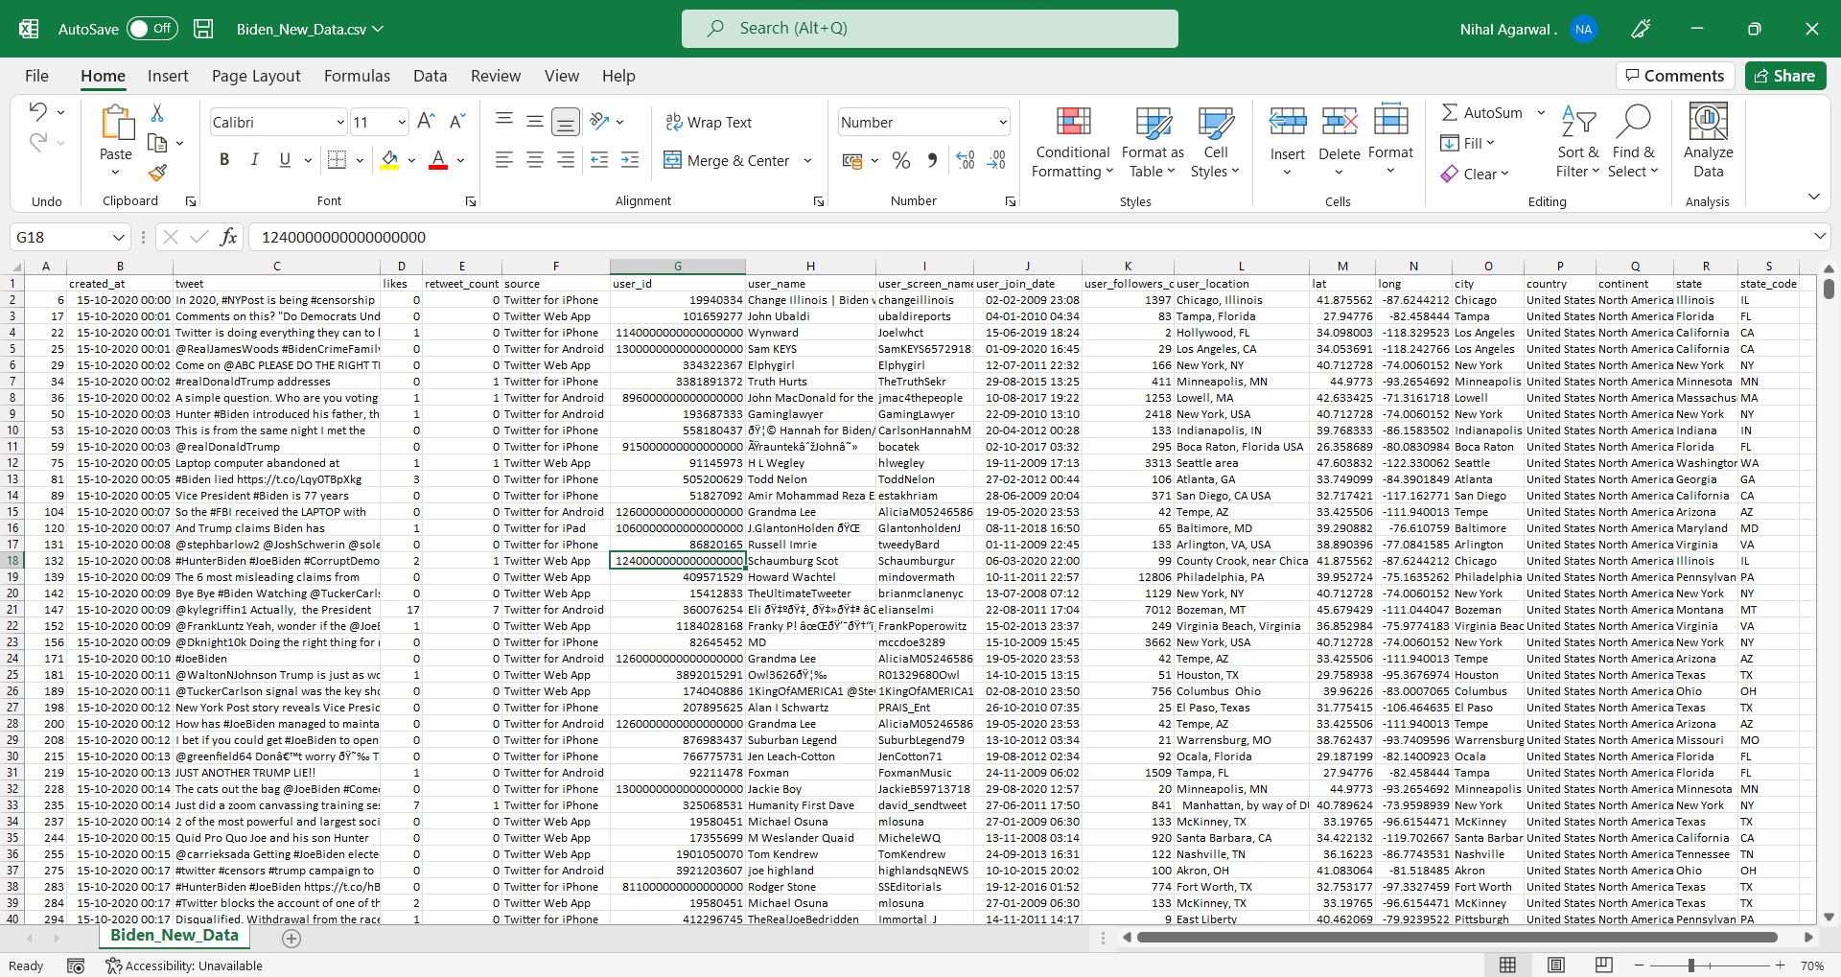
BIDEN DATASET
25-10-2022
BATCH - 11 TWEETS SENTIMENT ANALYSIS FOR US ELECTIONS - 2020
10

Slide 11
WORK PROGRESS
Importing dataset and libraries needed for analysis.
Importing all natural language tool kit libraries for data cleaning and model evaluation.
Skimming and scanning the datasets and understanding the distribution in the data.
Cleaning the dataset initially - removing null values, and unwanted columns that doesn't help in our analysis and dropping them.
Sorting the values from first date of tweet and first time of tweet to last date of tweet to last time of tweet.
Then visualize the tweets only from united states country, we have all types of countries , so filter the united states and replace them to whole us data and join them at that axis.
Then count the tweets from each city in us and group them in ascending order and prepare a data frame for them to understand the distribution.
Based on the number of states visualize the graph between states vs no of tweets.
Clean the data for analysis.
25-10-2022
BATCH - 11 TWEETS SENTIMENT ANALYSIS FOR US ELECTIONS - 2020
11

Slide 12
WORK PROGRESS
We are storing all the words in trump tweets removing the stop words and noise in the data and cleaning them to store it in another list.
Similar, we are storing all the words in Biden tweets removing the stop words and noise in the data and cleaning them to store it in another list
Prepare functions that will assist subjectivity, polarity and values of the sentiments.
Calling all the trump tweets and understand the sentiment from it.
Prepare a new data frame for storing sentiment, polarity and subjectivity from it.
Visualization of sentiment counts for Trump
Visualization of sentiment counts for Biden
Biden tweets sentiment analysis
Word cloud for sentiment analysis for Trump
Word cloud for sentiment analysis for Biden
25-10-2022
BATCH - 11 TWEETS SENTIMENT ANALYSIS FOR US ELECTIONS - 2020
12

Slide 13
WORK PROGRESS
Comparative analysis for VADER model and TextBlob model.
Clean the data and found hashtags and mentions for re-tweets.
Found a corelation for number of re-tweets for Trump and Biden and found number of hashtags for Trump and Biden.
Created a sentiment analysis graph from starting day till the day of election.
25-10-2022
BATCH - 11 TWEETS SENTIMENT ANALYSIS FOR US ELECTIONS - 2020
13

Slide 14
CODE IMPLEMENTATION
25-10-2022
BATCH - 11 TWEETS SENTIMENT ANALYSIS FOR US ELECTIONS - 2020
14

Slide 15
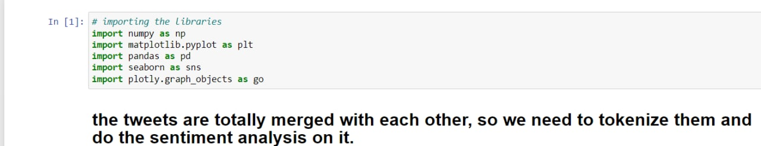
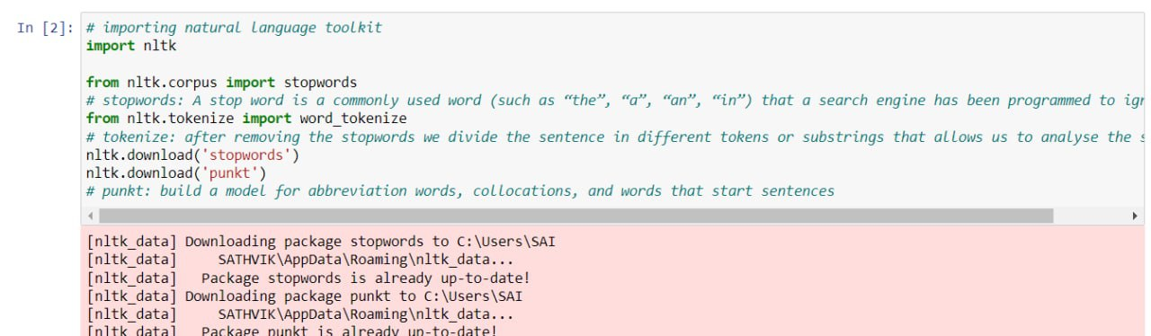
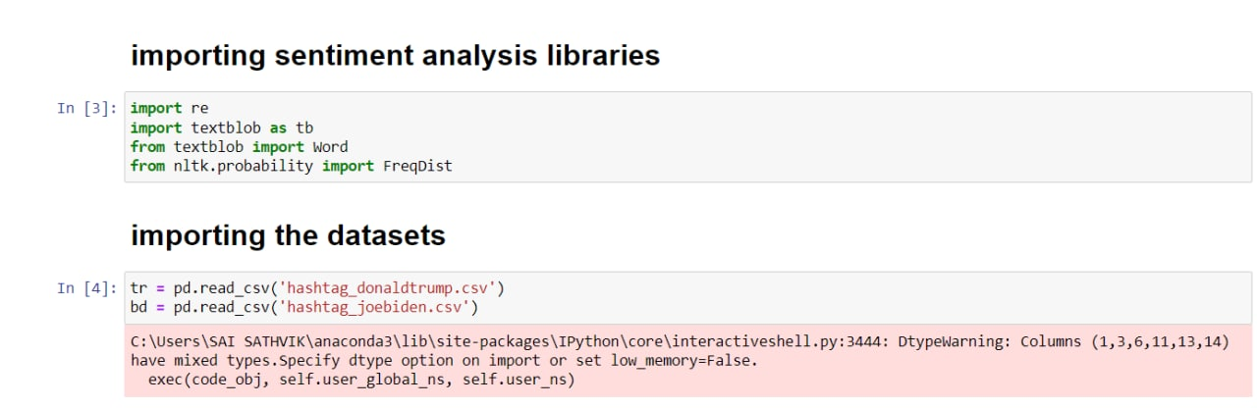
CODE IMPLEMENTATION
25-10-2022
BATCH - 11 TWEETS SENTIMENT ANALYSIS FOR US ELECTIONS - 2020
15

Slide 16
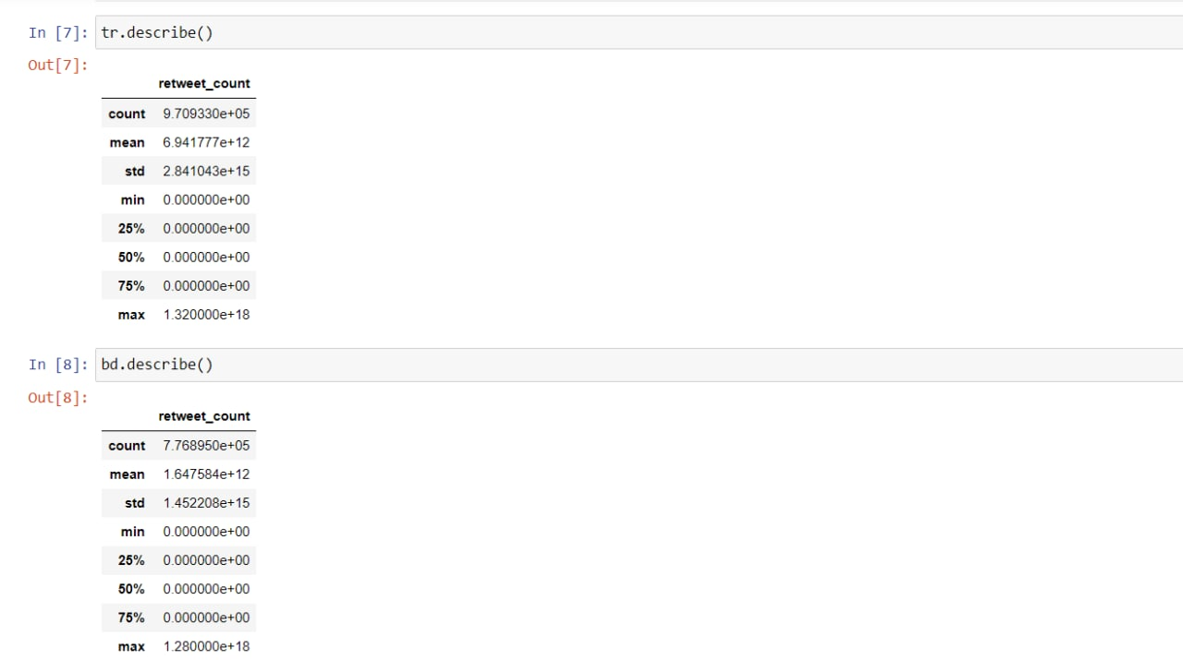
CODE IMPLEMENTATION
25-10-2022
BATCH - 11 TWEETS SENTIMENT ANALYSIS FOR US ELECTIONS - 2020
16

Slide 17
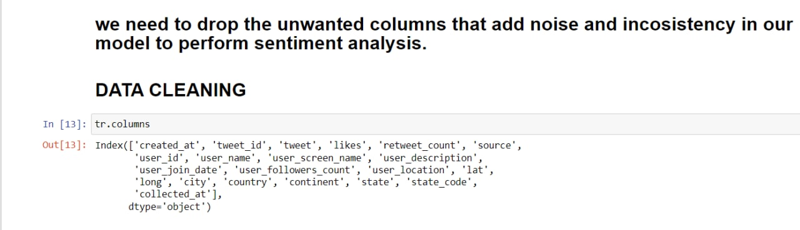
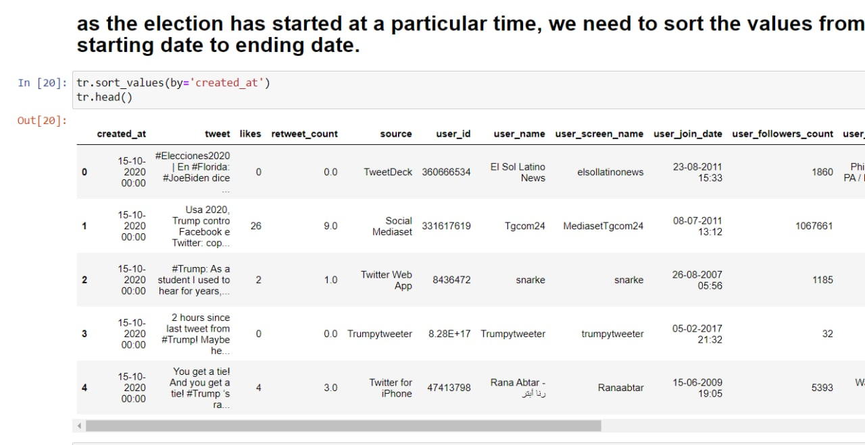
CODE IMPLEMENTATION
25-10-2022
BATCH - 11 TWEETS SENTIMENT ANALYSIS FOR US ELECTIONS - 2020
17

Slide 18
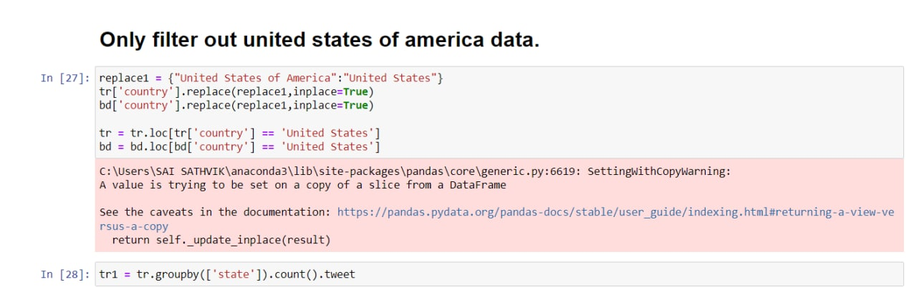
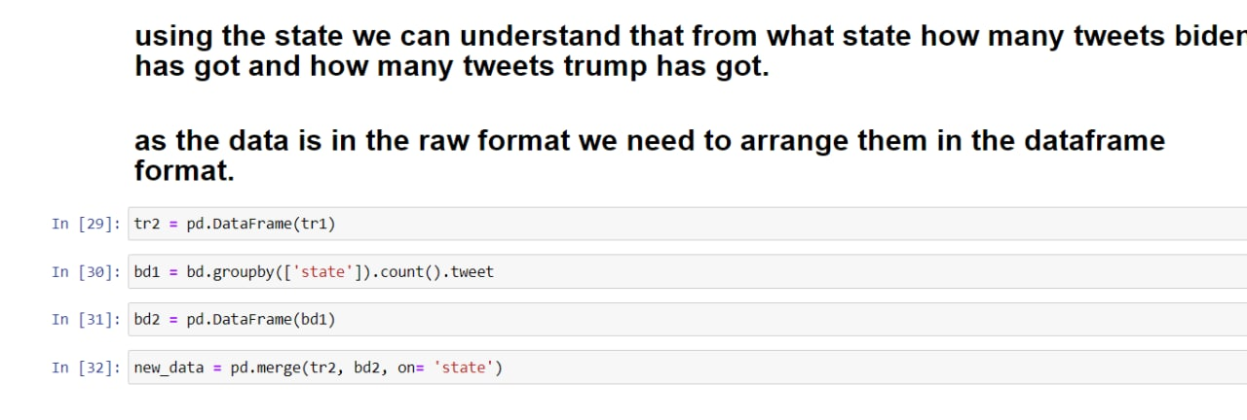
CODE IMPLEMENTATION
25-10-2022
BATCH - 11 TWEETS SENTIMENT ANALYSIS FOR US ELECTIONS - 2020
18

Slide 19
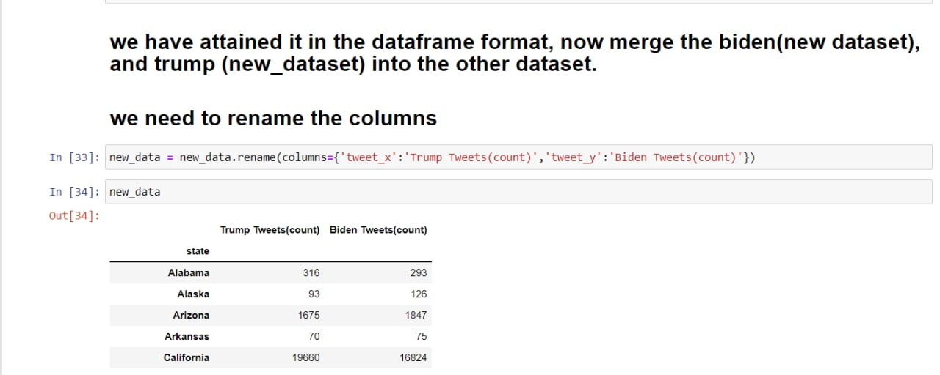
CODE IMPLEMENTATION
25-10-2022
BATCH - 11 TWEETS SENTIMENT ANALYSIS FOR US ELECTIONS - 2020
19

Slide 20
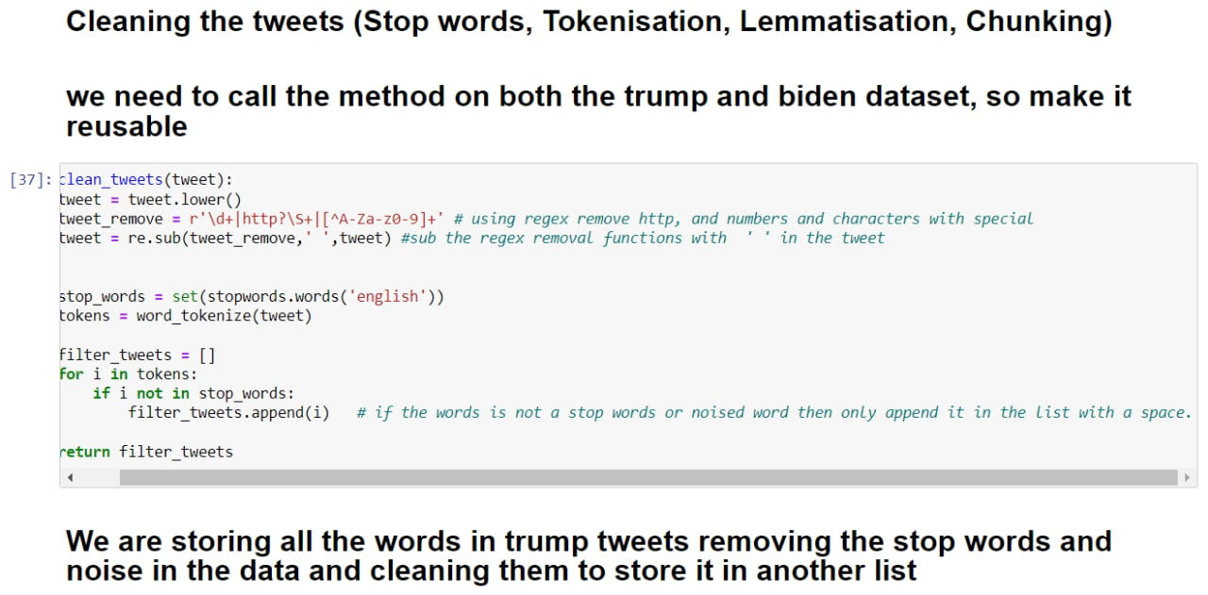
CODE IMPLEMENTATION
25-10-2022
BATCH - 11 TWEETS SENTIMENT ANALYSIS FOR US ELECTIONS - 2020
20

Slide 21
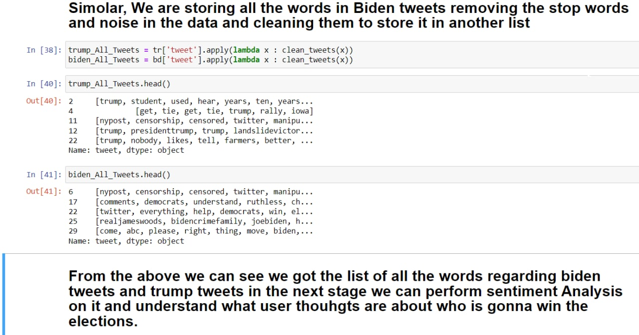
CODE IMPLEMENTATION
25-10-2022
BATCH - 11 TWEETS SENTIMENT ANALYSIS FOR US ELECTIONS - 2020
21

Slide 22
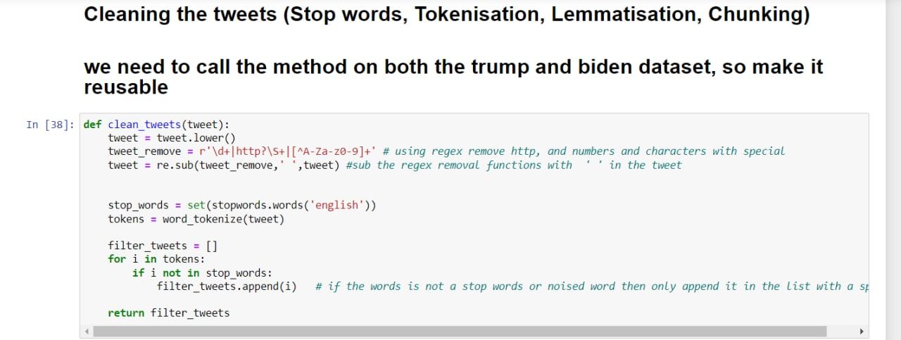
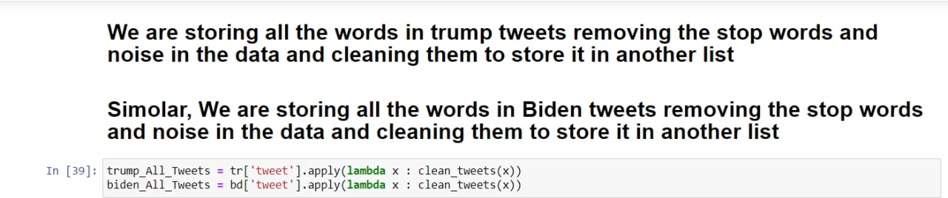
CODE IMPLEMENTATION
25-10-2022
BATCH - 11 TWEETS SENTIMENT ANALYSIS FOR US ELECTIONS - 2020
22

Slide 23
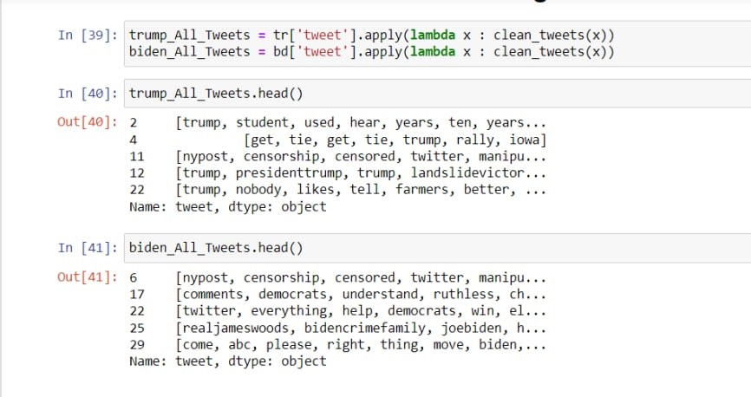
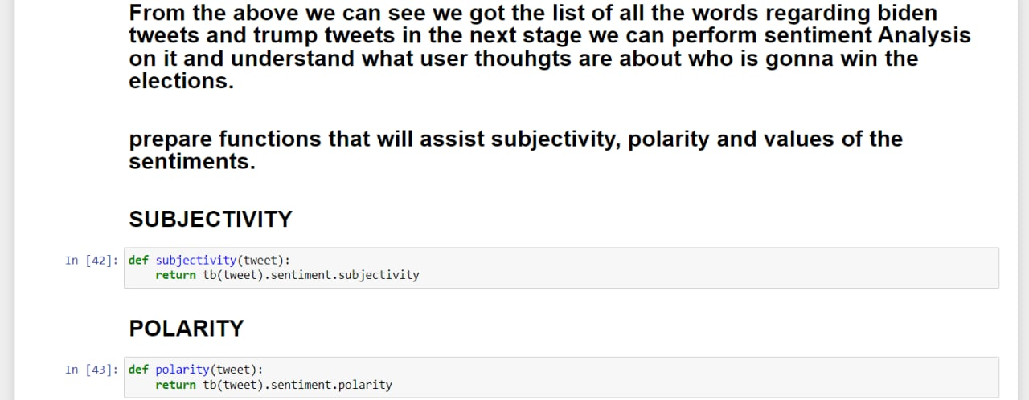
CODE IMPLEMENTATION
25-10-2022
BATCH - 11 TWEETS SENTIMENT ANALYSIS FOR US ELECTIONS - 2020
23

Slide 24
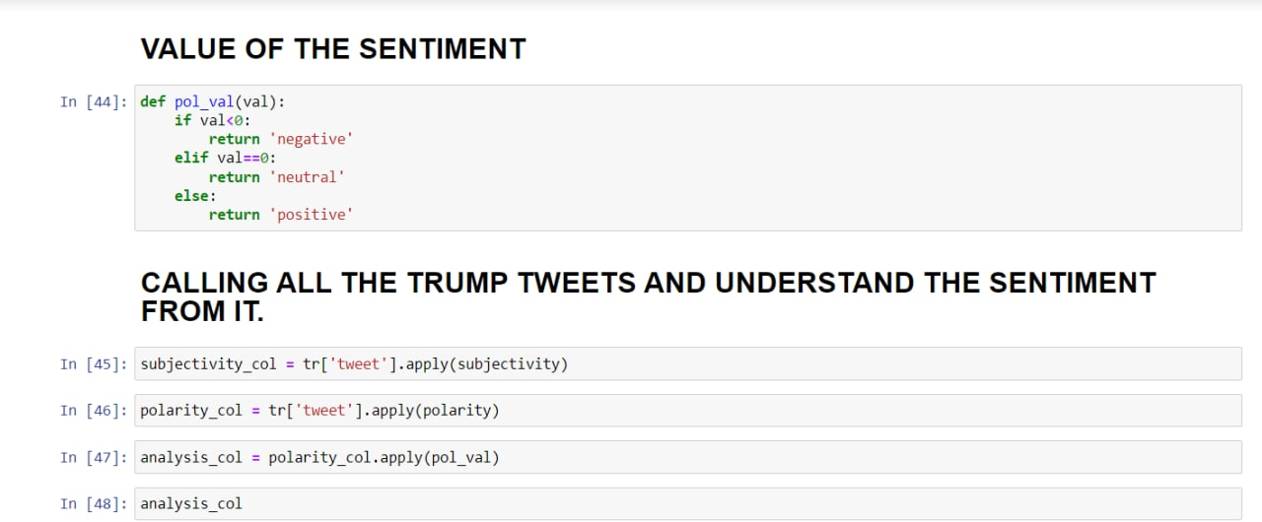
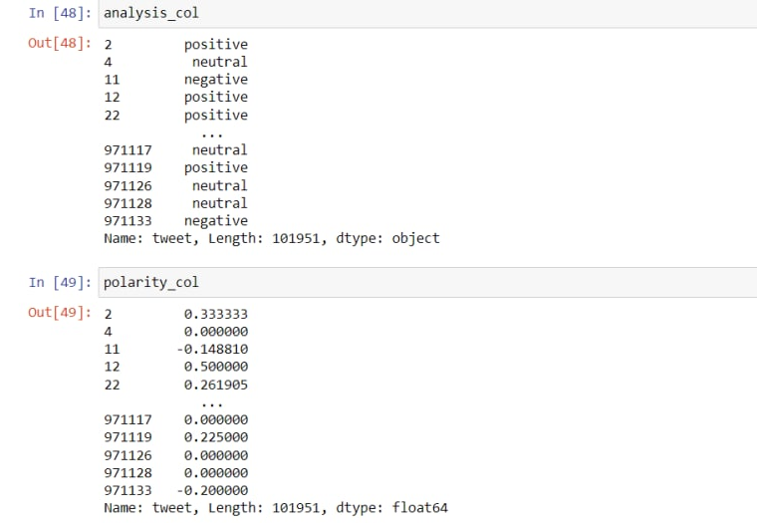
CODE IMPLEMENTATION
25-10-2022
BATCH - 11 TWEETS SENTIMENT ANALYSIS FOR US ELECTIONS - 2020
24

Slide 25
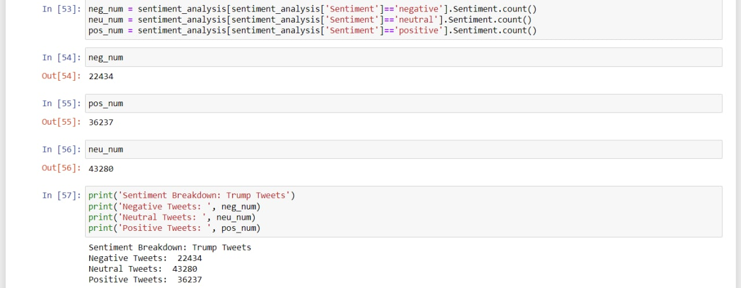
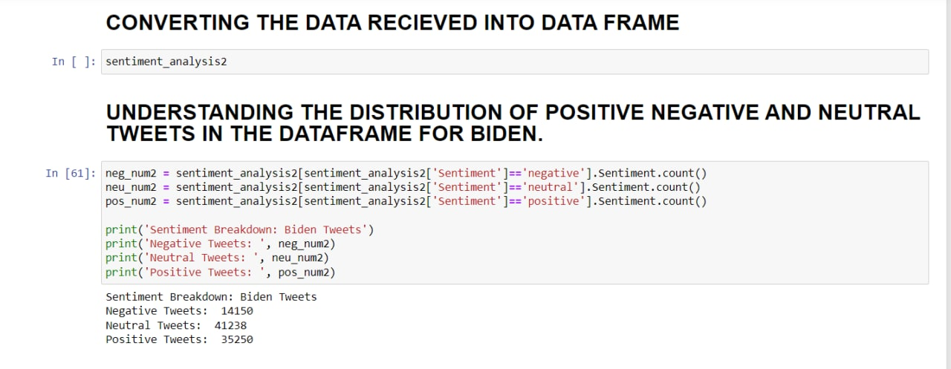
CODE IMPLEMENTATION
25-10-2022
BATCH - 11 TWEETS SENTIMENT ANALYSIS FOR US ELECTIONS - 2020
25

Slide 26
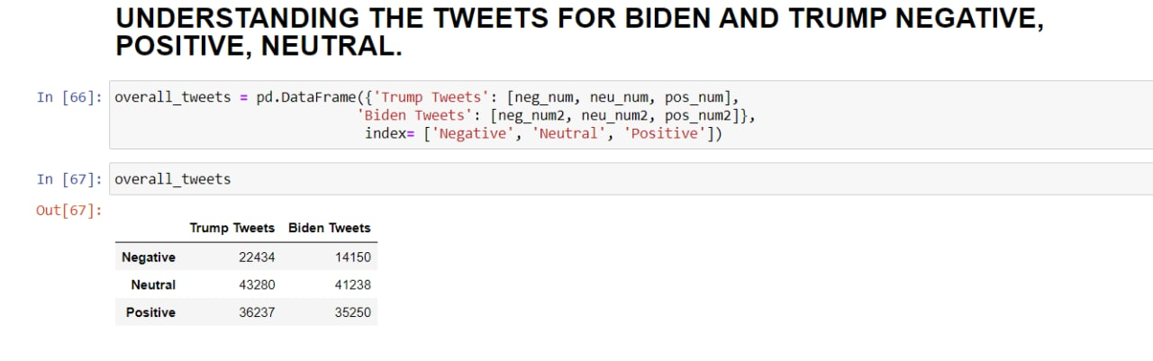
CODE IMPLEMENTATION
25-10-2022
BATCH - 11 TWEETS SENTIMENT ANALYSIS FOR US ELECTIONS - 2020
26

Slide 27
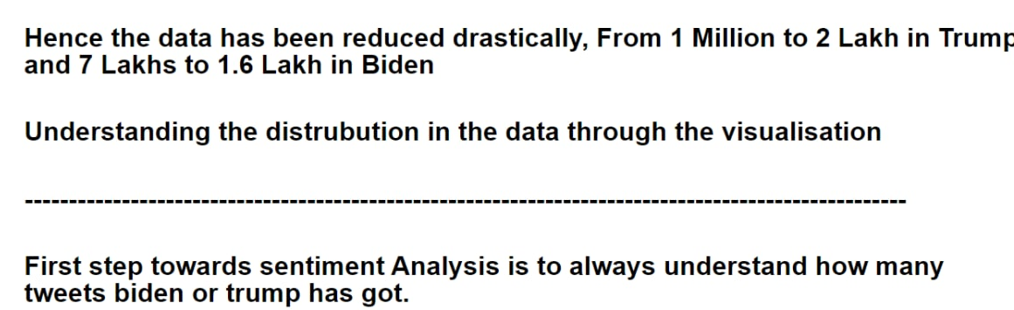
OUTPUT
25-10-2022
BATCH - 11 TWEETS SENTIMENT ANALYSIS FOR US ELECTIONS - 2020
27

Slide 28
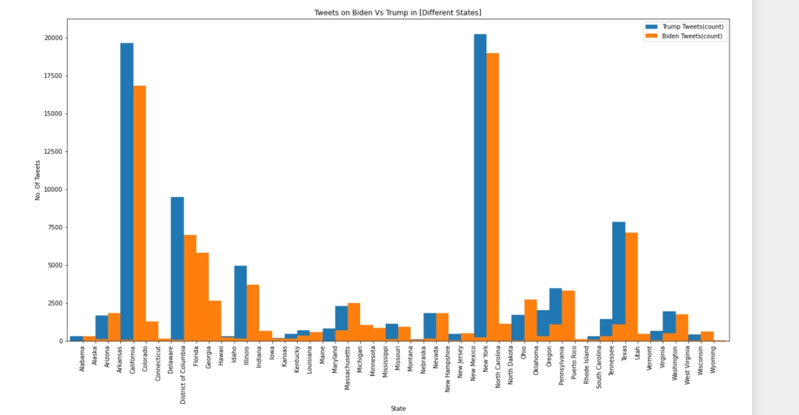
OUTPUT
25-10-2022
BATCH - 11 TWEETS SENTIMENT ANALYSIS FOR US ELECTIONS - 2020
28

Slide 29
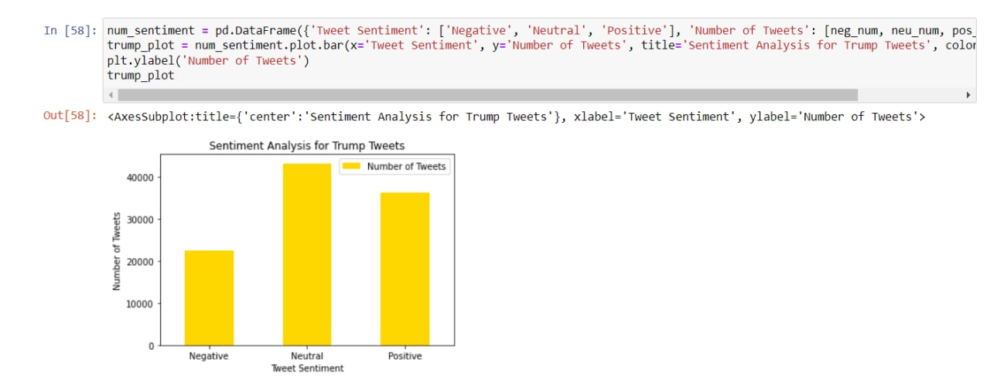
OUTPUT
25-10-2022
BATCH - 11 TWEETS SENTIMENT ANALYSIS FOR US ELECTIONS - 2020
29

Slide 30
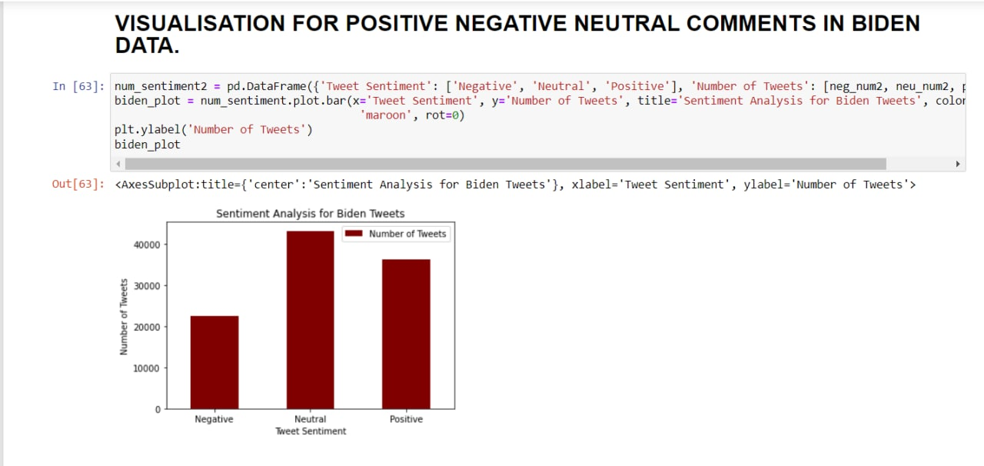
OUTPUT
25-10-2022
BATCH - 11 TWEETS SENTIMENT ANALYSIS FOR US ELECTIONS - 2020
30

Slide 31
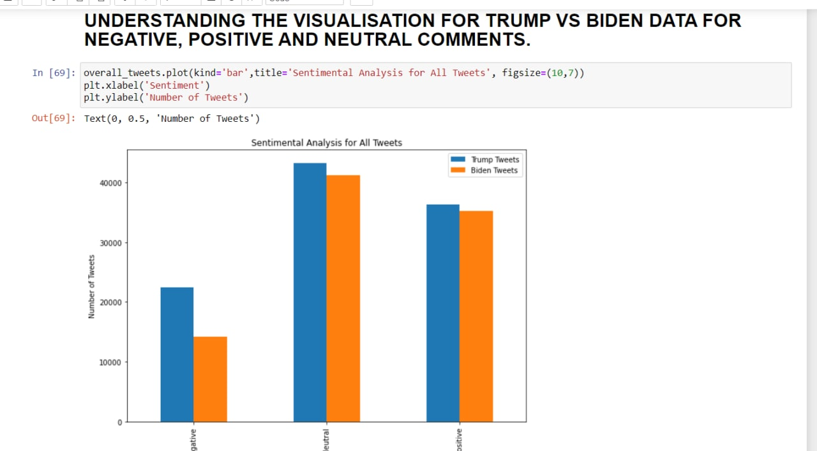
OUTPUT
25-10-2022
BATCH - 11 TWEETS SENTIMENT ANALYSIS FOR US ELECTIONS - 2020
31

Slide 32
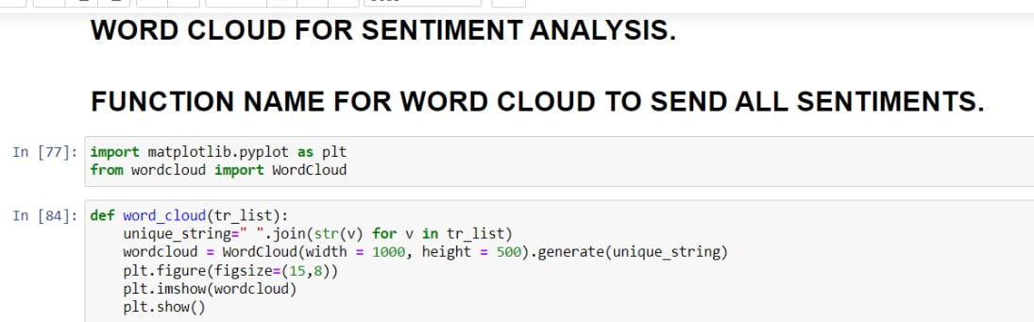
OUTPUT
25-10-2022
BATCH - 11 TWEETS SENTIMENT ANALYSIS FOR US ELECTIONS - 2020
32

Slide 33
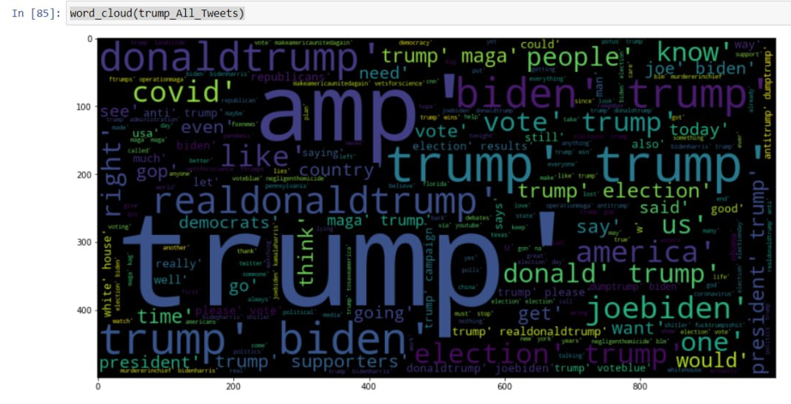
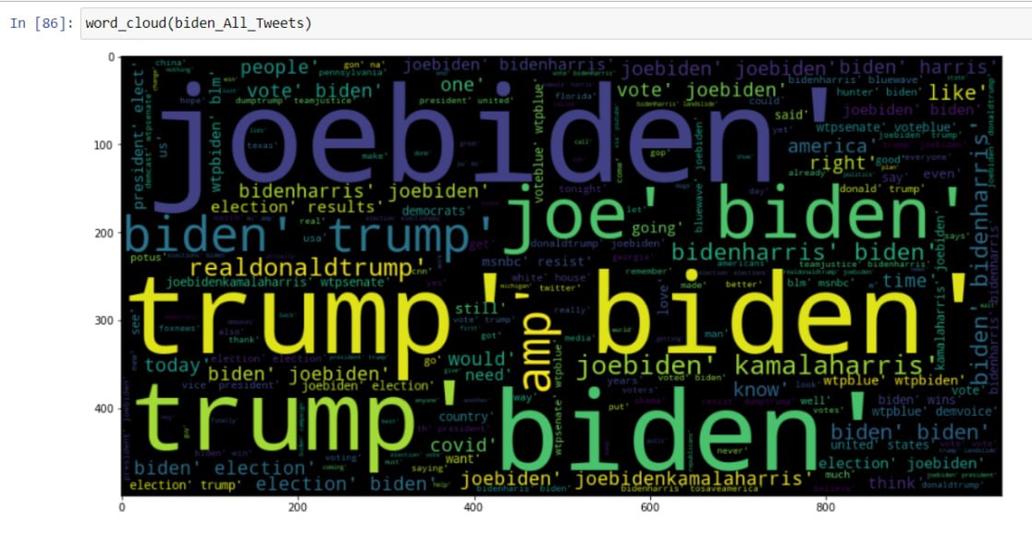
OUTPUT
25-10-2022
BATCH - 11 TWEETS SENTIMENT ANALYSIS FOR US ELECTIONS - 2020
33

Slide 34
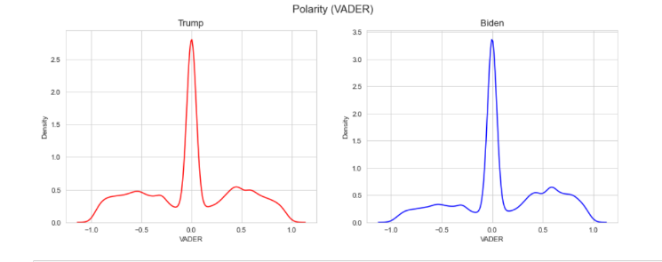
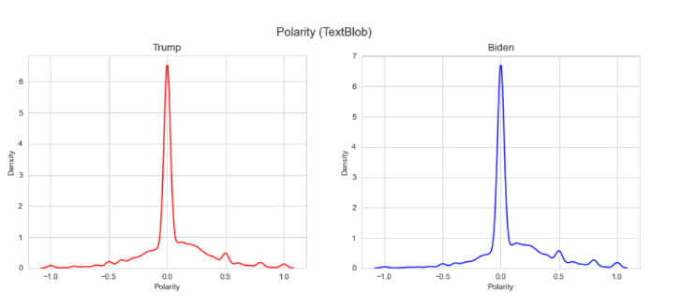
OUTPUT
VADER
TEXTBLOB
Showing the distribution between Trump and Biden for polarity differences for extreme negative
25-10-2022
BATCH - 11 TWEETS SENTIMENT ANALYSIS FOR US ELECTIONS - 2020
34

Slide 35
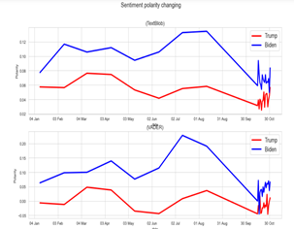
OUTPUT
Sentiment Analysis Graph from Jan – 4 till Election Date
25-10-2022
BATCH - 11 TWEETS SENTIMENT ANALYSIS FOR US ELECTIONS - 2020
35

Slide 36
GITHUB REPOSITORY
https://github.com/nihal136/Twitter_Sentiment_Analysis
25-10-2022
BATCH - 11 TWEETS SENTIMENT ANALYSIS FOR US ELECTIONS - 2020
36

Slide 37
RESULTS & DISCUSSIONS
There is enthusiasm in the United States politics from many various locations around the world, as evidenced by the tweeting in 40 multiple dialects, but there is a lopsided tweet in English and originating from the USA. Merely information from United States of America including spatial was utilized for the sentiment analysis, that aimed to find individual presidential voter's sentiments in each distinct dataset. While examining sentiment at the state and local level as the election date came closer, a sizable majority of states were trending to a "Positive" sentiment polarity again for dem candidate over a formerly stronger "Neutral" sentiment. Whereas a handful of Conservative states are similar space neutral. This pattern can be altered when examining at sentiment classification from a data viewpoint.
25-10-2022
BATCH - 11 TWEETS SENTIMENT ANALYSIS FOR US ELECTIONS - 2020
37

Slide 38
CONCLUSION
It is clear from the research above that sentiment analysis is highly accurate when used to analyze the outcomes of the 2020 US presidential election. Sentiment analysis is also ideal for evaluating any data that contains text or words, which of course calls for analysis. We got it through Twitter, but it would also be possible to use data from surveys or other social media sites for additional study. Naturally, the results we obtain may still be improved upon; by comparing neutral, positive, and negative attitudes, more study may be able to offer a more reassures of sentiments. The usage of EDA, VADER, and Text Blob in this experiment can be extremely accurate and capable of creating nice visualizations, although some more refinements are needed. Even so, as a summary, this sentiment classification study is expected to provide sufficient inspiration to viewers to undertake similar work, to aid election attendees in autonomously assessing one ‘s electoral results, and potentially both candidates in deciding what feedback or viewpoints their voters possess.
25-10-2022
BATCH - 11 TWEETS SENTIMENT ANALYSIS FOR US ELECTIONS - 2020
38

Slide 39
THANK YOU
Mentor: Dr. K Sreenivasa Rao
25-10-2022
BATCH - 11 TWEETS SENTIMENT ANALYSIS FOR US ELECTIONS - 2020
39

